Slide 1
Simple Linear Regression

Slide 2
The general equation of a line is Y = c + mX or Y = α + βX.
α > 0
β < 0
α > 0
β > 0
α = 0
β < 0
α > 0
β = 0

Slide 3
Regression analysis is a technique for quantifying the relationship between a response variable (or dependent variable) and one or more predictor (independent or explanatory) variables.
Two Main Purposes:
  To predict the dependent variable based on specified values for the predictor variable(s).
  To understand how the predictor variable(s) influence or relate to the dependent variable.

Slide 4
Example - Humidity Data
The raw material used in the production of a certain synthetic fiber is stored in a location without humidity control. Measurements of the relative humidity in the storage location and the moisture content (in %) of a sample of the raw material were taken over 15 days.
  Rel. Humidity: 46, 53, 29, 61, 36, 39, 47, 49,
  Mois. Content: 12, 15, 7, 17, 10, 11, 11, 12,
  Rel. Humidity: 52, 38, 55, 32, 57, 54, 44.
  Mois. Content: 14, 9, 16, 8, 18, 14, 12.
Relative Humidity takes the role of explanatory variable.
Moisture Content takes the role of dependent variable.

Slide 5
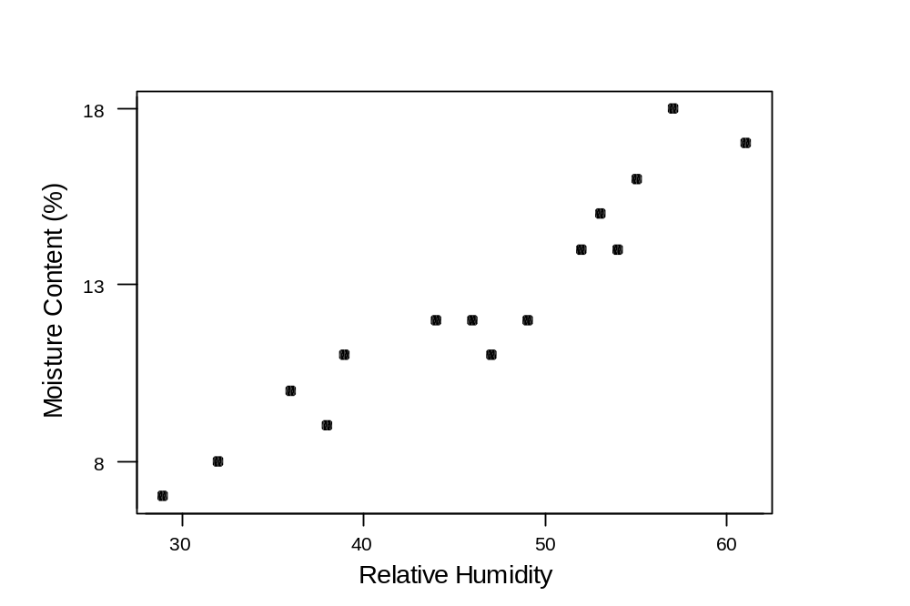

Slide 6
The Regression Model
The Simple Linear Regression Model can be stated as
Y_{i} = α + βX_{i} + ε_{i}
Y_{i} is the value of the response variable in the i^{th} trial
α and β are the intercept and slope parameters
X_{i} is a known constant, namely the value of the explanatory variable in the ith trial
ε_{i} is an unobservable random error term such that ε_{i}~N(0,σ²). ε_{i} is also referred to as the stochastic element of the regression model Y_{i} = α + βX_{i} + ε_{i}.

Slide 7

Minimise Vertical Distances of Data to ‘Best Fit Line’

Slide 8
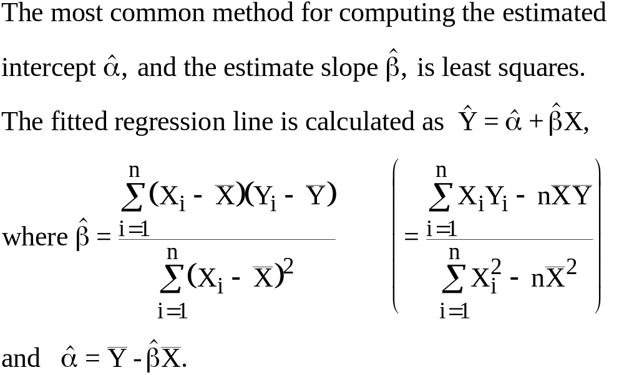
Formulae For Least Squares Method

Slide 9
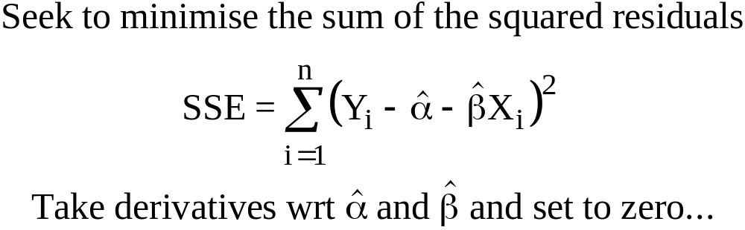
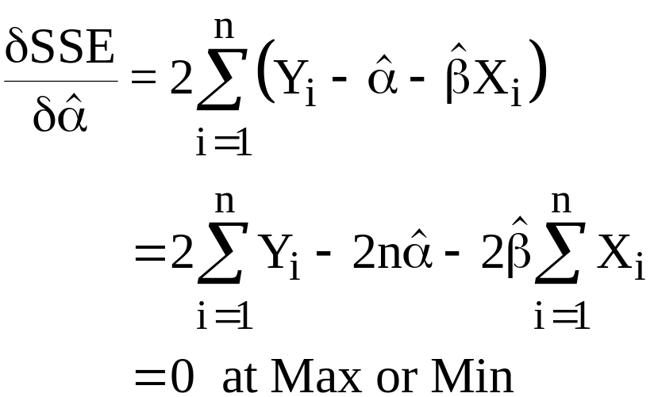
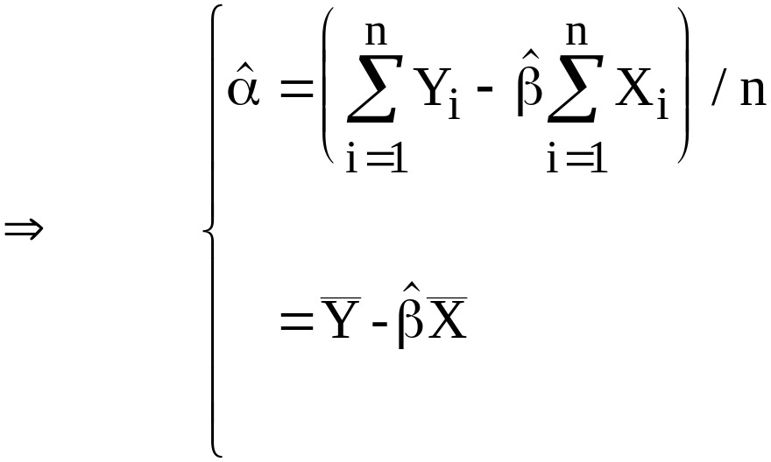
LEAST SQUARES ESTIMATES

Slide 10
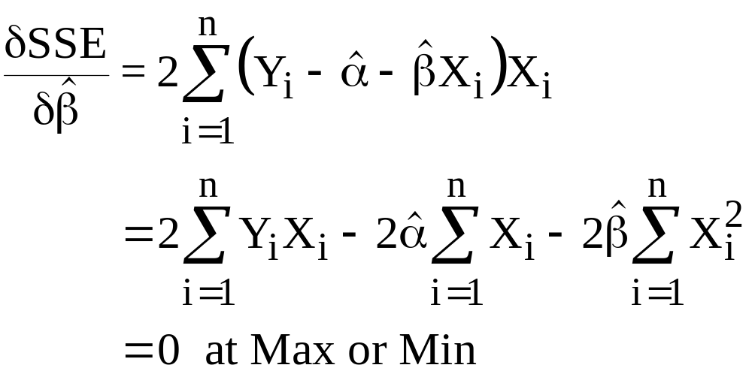

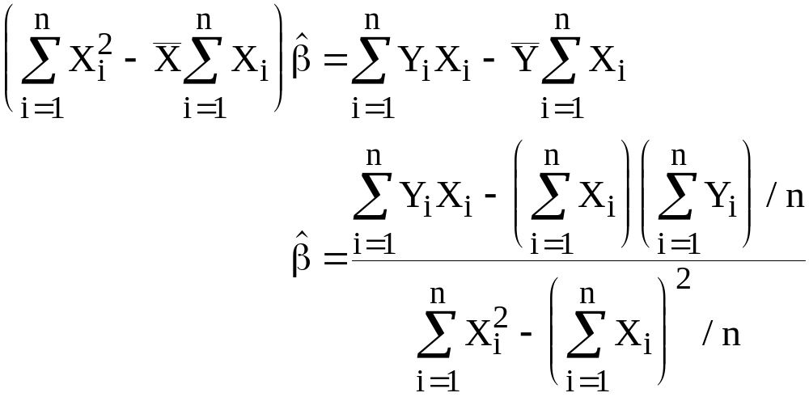

Slide 11
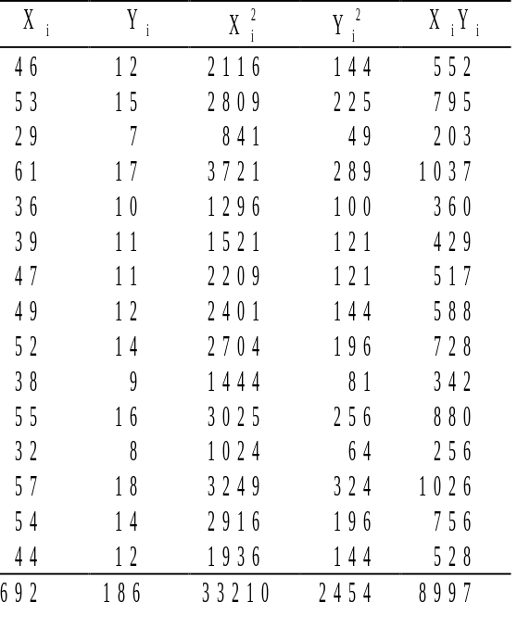
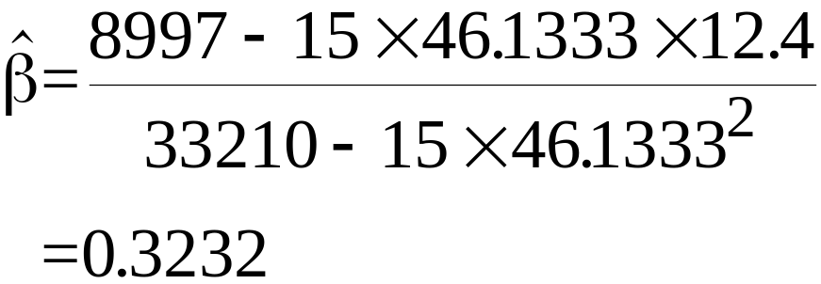
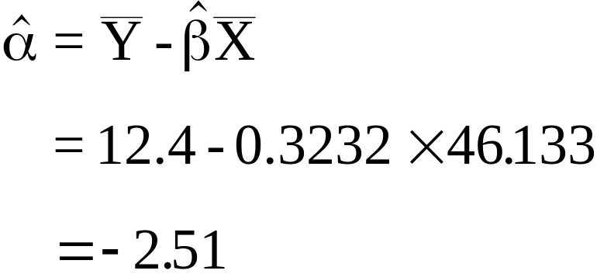
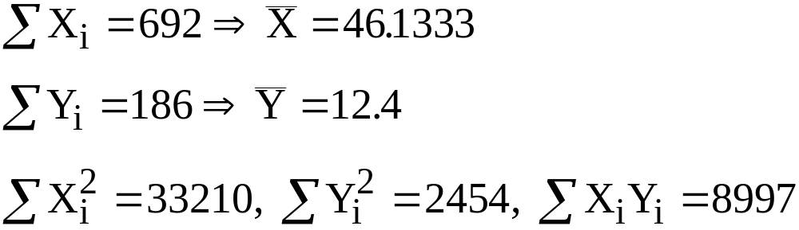

Slide 12
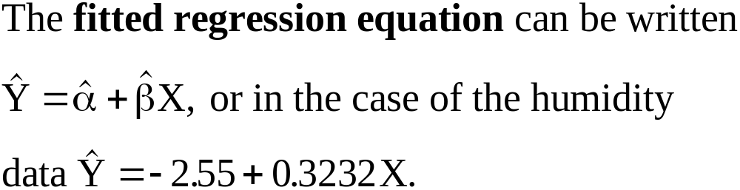
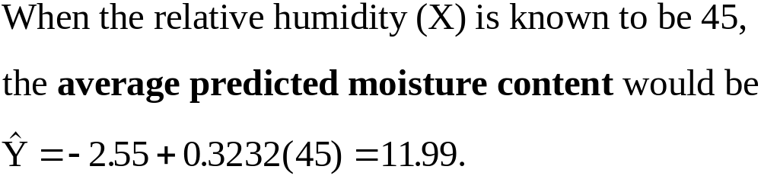

Slide 13
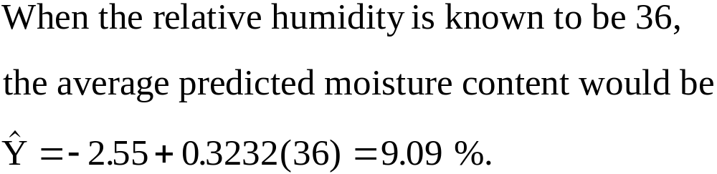
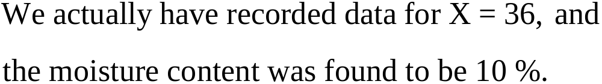
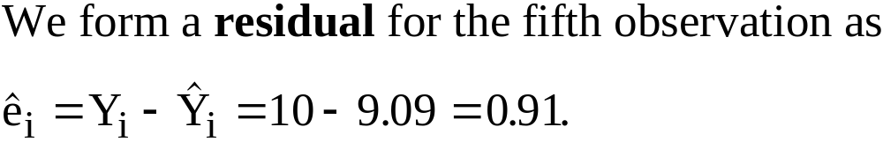

Slide 14
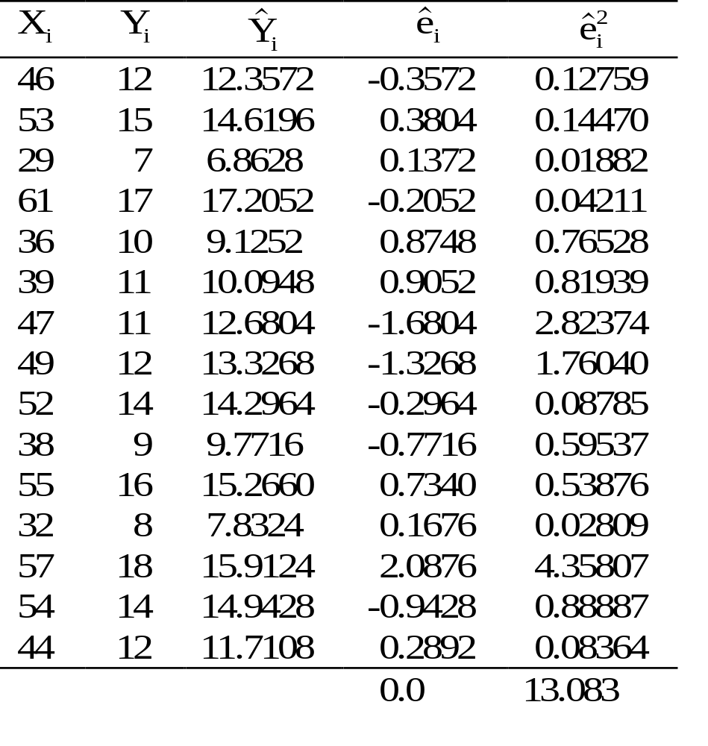
RESIDUAL = DATA - MODEL
= SSE

Slide 15
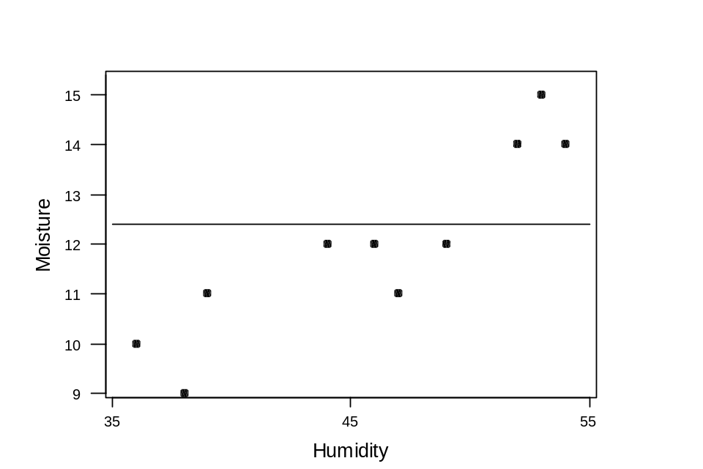
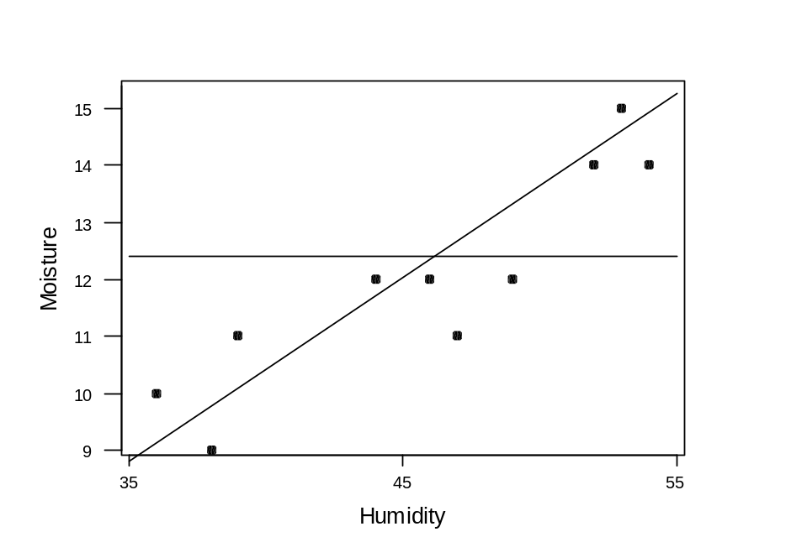



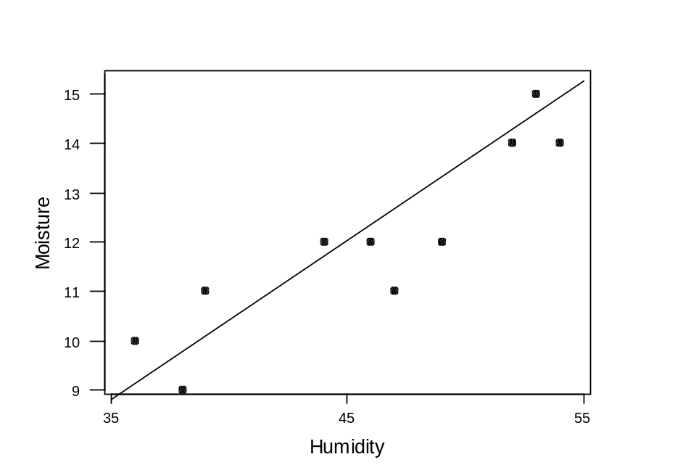
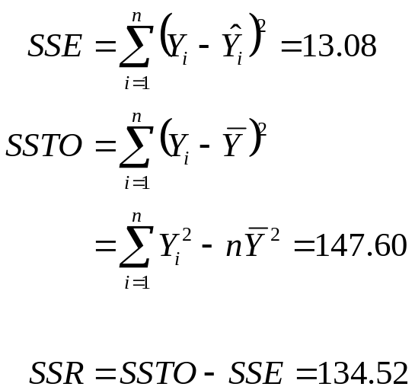


Slide 16
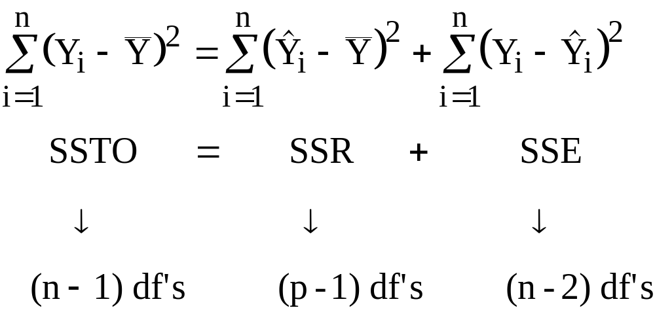
Total
Variation
Explained
Variation
Unexplained
Variation
=
+
where p equals the number of parameters being estimated, in our case p = 2, (. intercept and slope).

Slide 17
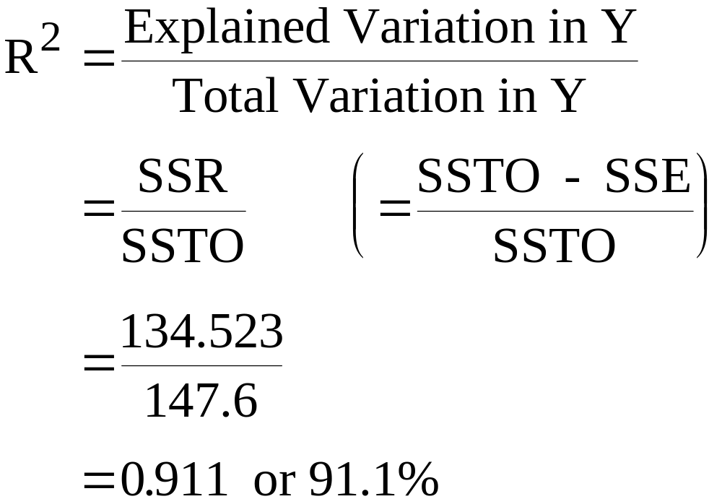
A Measure of the Relative Goodness-Of-Fit
R² is interpreted as the percentage variation in the response variable Y, explained through the simple linear regression on the explanatory variable X.

Slide 18
The regression equation is
Moisture = - 2.51 + 0.323 Humidity
Predictor Coef StDev T P
Constant -2.510 1.315 -1.91 0.079
Humidity 0.32320 0.02796 11.56 0.000
S = 1.003 R-Sq = 91.1%
Analysis of Variance
Source DF SS MS F P
Regression 1 134.52 134.52 133.67 0.000
Error 13 13.08 1.01
Total 14 147.60
on 13 degrees of freedom

Slide 19
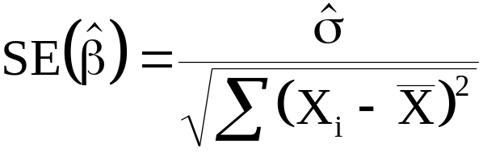
Estimating A Confidence Interval for β
Using statistical theory we can derive a formula for the standard error of β
We may use a confidence interval to quantify the uncertainty associated with the slope.
A confidence interval will be calculated as the point estimate + a value from the tables times the standard error of the point estimate…...

Slide 20
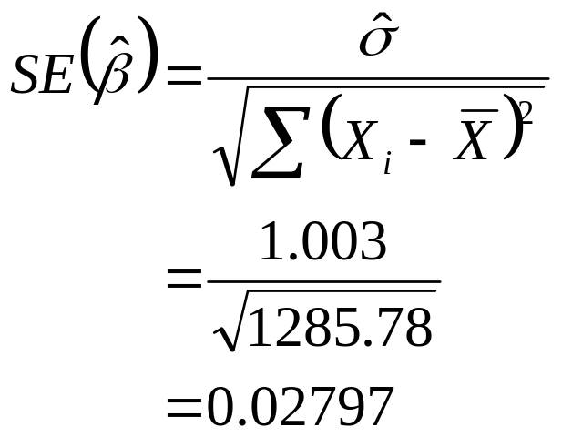
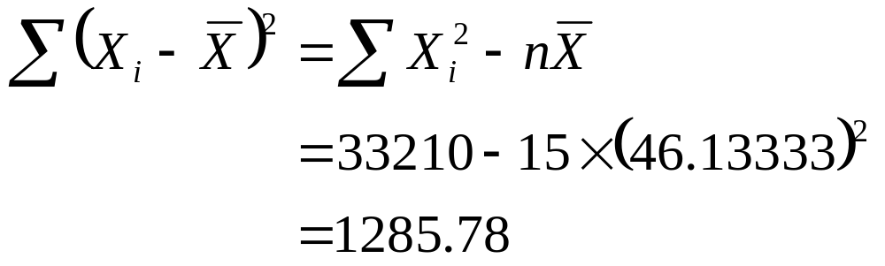
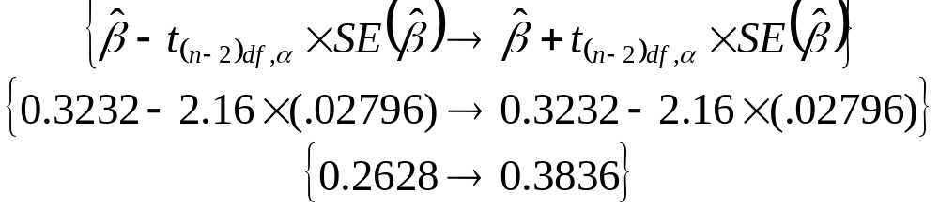
Comes from a t-distribution on (n-2) = 13 degrees of freedom
Read from MINITAB output.

Slide 21
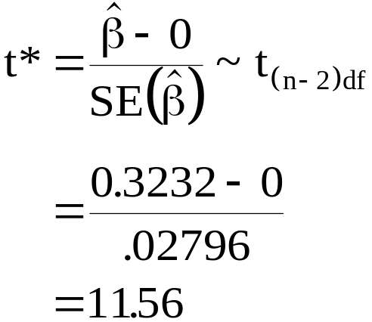
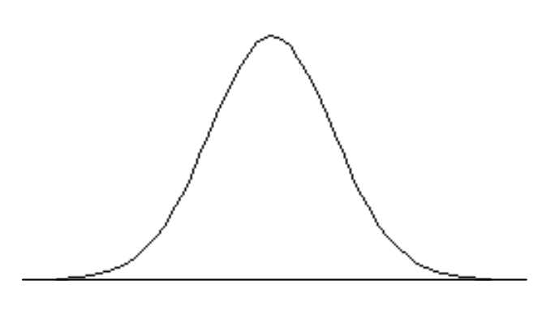
Hypothesis Testing About β
      Ho: β = 0 (% Moist. per Rel. Hum.)
      Ha: β ≠ 0 (% Moist. per Rel. Hum.)
With a 0.05 level of significance the decision rule is reject Ho if t* < -2.16 or if t* > +2.16
t-distribution on 13 df
2.5%
95%
2.5%
Reject Ho: β = 0
-2.16
+2.16

Slide 22
The regression equation is
Moisture = - 2.51 + 0.323 Humidity
Predictor Coef StDev T P
Constant -2.510 1.315 -1.91 0.079
Humidity 0.32320 0.02796 11.56 0.000
S = 1.003 R-Sq = 91.1%
Analysis of Variance
Source DF SS MS F P
Regression 1 134.52 134.52 133.67 0.000
Error 13 13.08 1.01
Total 14 147.60
÷
=

Slide 23
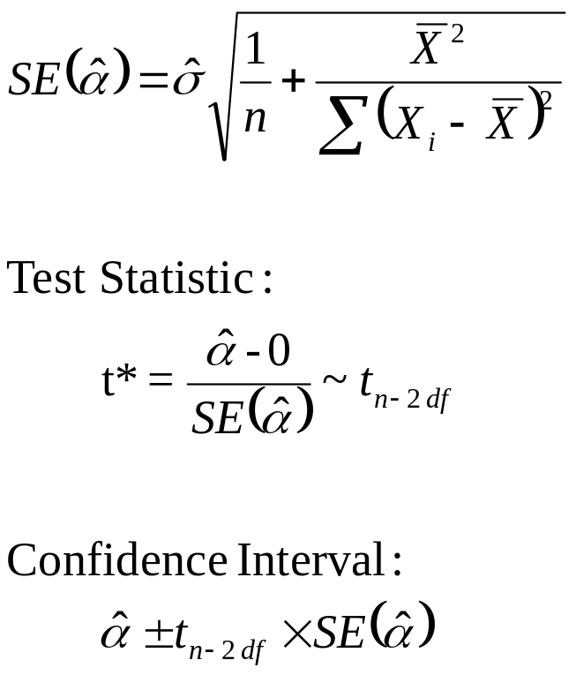
Statistical Inference for α

Slide 24
The regression equation is
Moisture = - 2.51 + 0.323 Humidity
Predictor Coef StDev T P
Constant -2.510 1.315 -1.91 0.079
Humidity 0.32320 0.02796 11.56 0.000
S = 1.003 R-Sq = 91.1%
11.56 × 11.56 = 133.63
Analysis of Variance
Source DF SS MS F P
Regression 1 134.52 134.52 133.67 0.000
Error 13 13.08 1.01
Total 14 147.60

Slide 25
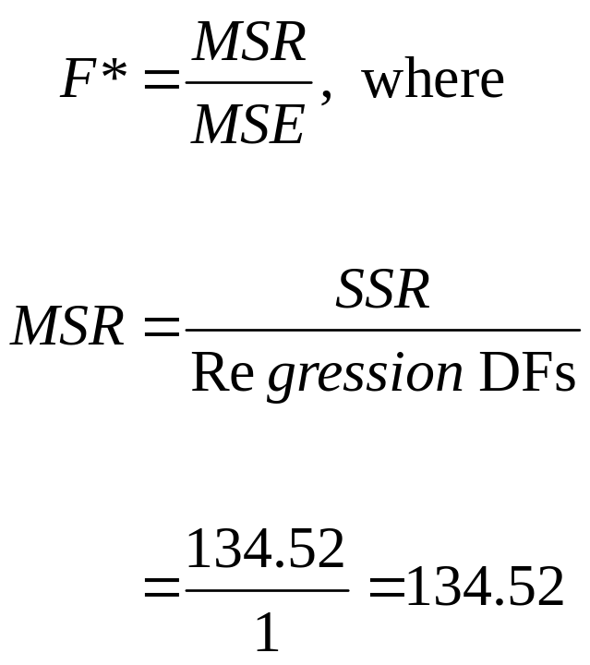
F-Test: Ho: β = 0 (% Moist. per Rel. Hum.)
      Ha: β ≠ 0 (% Moist. per Rel. Hum.)
Note: Large values of F* lead to the rejection of Ho
Critical Value = F_{.05} = 4.67
  1df Numerator,
  13df Denominator

Slide 26
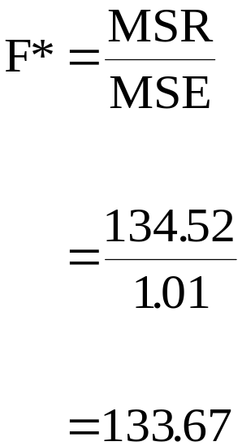
Decision Rule:
      Fail to accept Ho if F* = MSR/MSE < 4.67
      Reject Ho if F* = MSR/MSE > 4.67
Area = 5%
Do Not Reject H₀
Reject H₀
4.67

Slide 27
options(show.signif.stars = FALSE)
humidity = c(46, 53, 29, 61, 36, 39, 47, 49, 52, 38, 55, 32, 57, 54, 44)
moisture = c(12, 15, 7, 17, 10, 11, 11, 12, 14, 9, 16, 8, 18, 14, 12)
slr = lm( moisture ~ humidity )
slr
summary(slr)
anova(slr)
plot(x = humidity, y = moisture)
abline(slr, col = "red", lwd = 2)
confint(slr)
fits = predict(slr, data.frame( humidity = seq(30,60,by=0.1)), se.fit = TRUE)
lines(seq(30,60,by=0.1), fits$fit + 2 * fits$se.fit, col = "blue", lty = 2)
lines(seq(30,60,by=0.1), fits$fit - 2 * fits$se.fit, col = "blue", lty = 2)

Slide 28
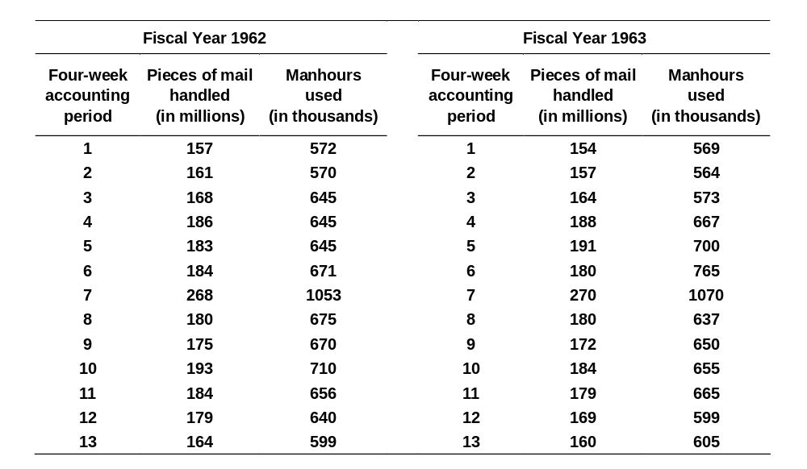
Mail Processing Hours
(Fiscal Years 1962 -63)

Slide 29
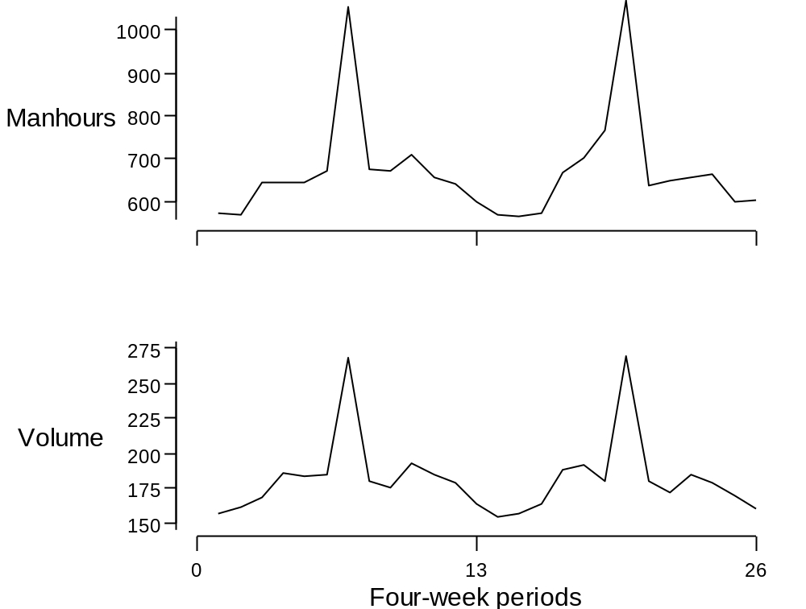
Line plots of Manhours and Volume

Slide 30
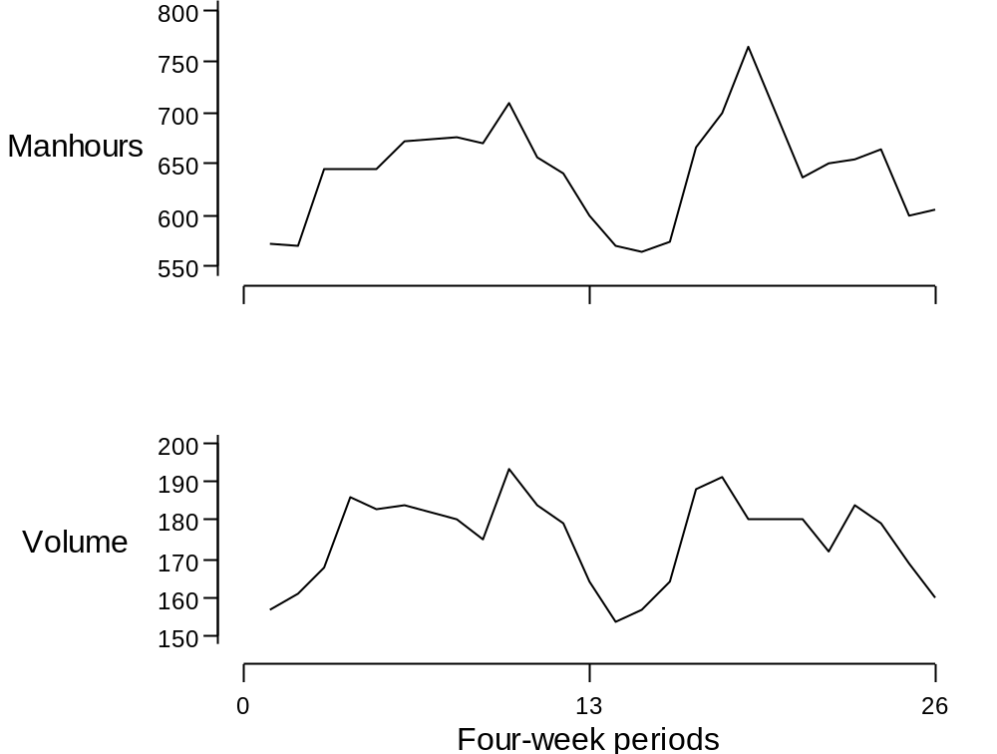
Line plots of Manhours and Volume
Christmas excluded

Slide 31
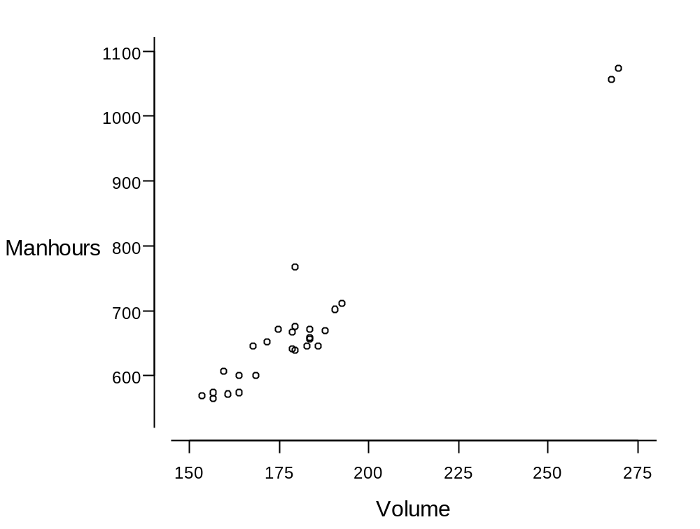
Scatter plots of Manhours and Volume

Slide 32
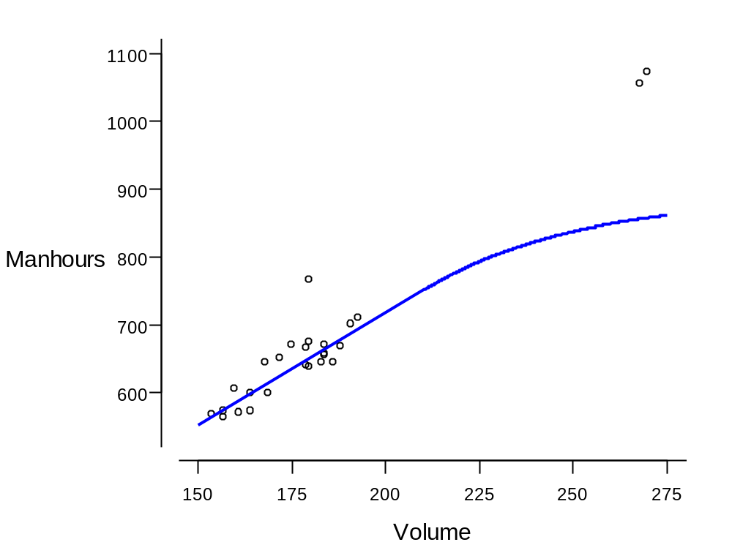
Scatter plots of Manhours and Volume with curve representing return to scale

Slide 33
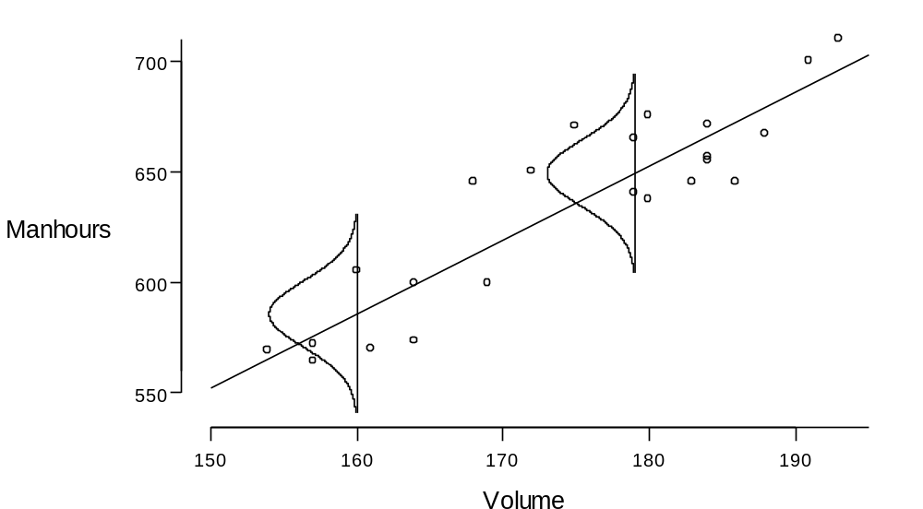
Simple linear regression model with Normal model for chance variation
Y = α + βX + ε

Slide 34
The simple linear regression model
Y = α + βX + ε
  Y is the Response variable
  X is the Explanatory variable
Model parameters:
  α and β are the linear parameters
  hidden parameter, standard deviation σ,
    measures spread of Normal curve

Slide 35
The simple linear regression model
Choosing values for the regression coefficients
  the method of least squares
Interpreting the fitted line
Using the fitted line; prediction
A model for chance causes of variation
Estimating σ

Slide 36
Case study:
Mail processing costs in a U.S. Post Office

Slide 37
Scatter plots of Manhours and Volume

Slide 38
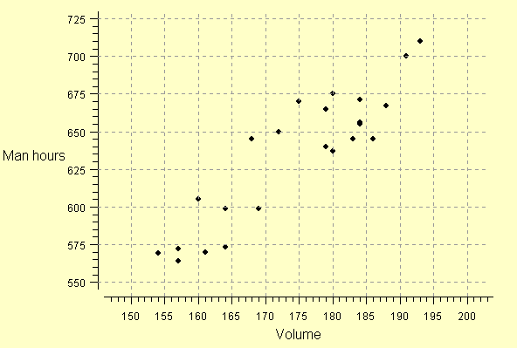
Scatter plot with grid
(to assist in reading x- and y-values)

Slide 39
Simple linear regression model with Normal model for chance variation
Y = α + βX + ε

Slide 40
The simple linear regression model
Y = α + βX + ε
  Y is the Response variable
  X is the Explanatory variable
Model parameters:
  α and β are the linear parameters
  hidden parameter, standard deviation σ,
    measures spread of Normal curve

Slide 41
Choosing values for the regression coefficients
Given values for α and β, the fitted values of Y are
  α + βX₁,
  α + βX₂,
  α + βX₃,
    •
    •
    •
  α + βX_{n}

Slide 42
Choosing values for the regression coefficients
Find values for α and β that minimise the deviations
  Y₁ − α − βX₁,
  Y₂ − α − βX₂,
  Y₃ − α − βX₃,
    •
    •
    •
  Y_{n} − α − βX_{n}

Slide 43
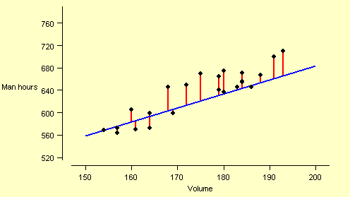
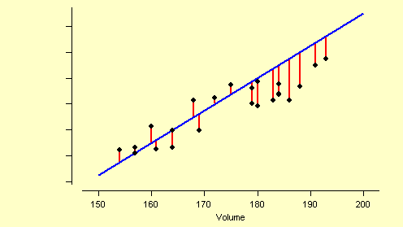
Trial regression lines, with "residuals"

Slide 44
The method of least squares
Find values for α and β that minimise the sum of the squared deviations:
  (Y₁ − α − βX₁)²
  + (Y₂ − α − βX₂)²
  + (Y₃ − α − βX₃)²
    •
    •
    •
  + (Y_{n} − α − βX)²

Slide 45
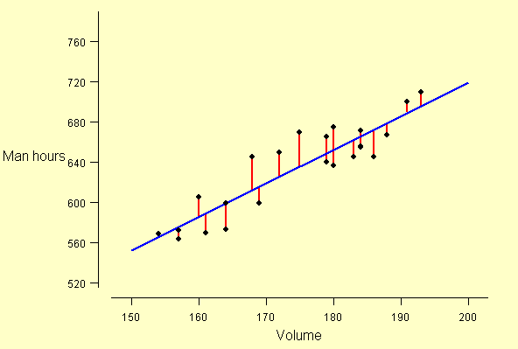
"Least squares" regression line, with "residuals"

Slide 46
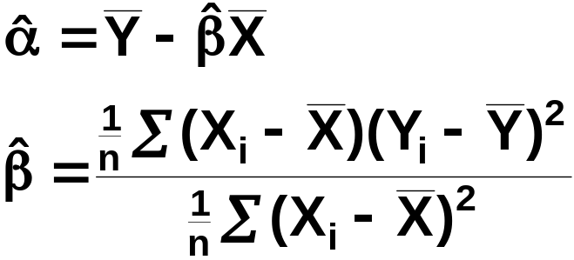
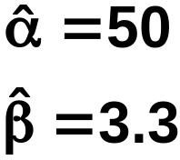
The method of least squares
Solution:
For these data,

Slide 47

Interpretation
is the marginal change in Y for a unit change in X.
Check the measurement units!
is overheads.
WARNING

Slide 48
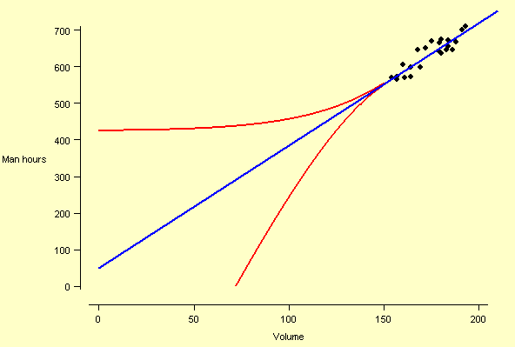
"Least squares" regression line, with non-linear extensions

Slide 49



Using the fitted line; prediction
Prediction equation:
Prediction equation allowing for chance variation:
Original model:
SD = σ

Slide 50
Simple linear regression model with Normal model for chance variation
Y = α + βX + ε

Slide 51


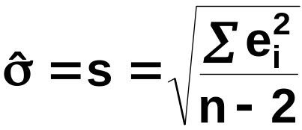
Estimating σ
σ measures spread of deviations from the true line.
Estimate σ by s, the standard deviation of deviations from the fitted line, via
fitted values:
and
residuals:
= 20
for our example

Slide 52
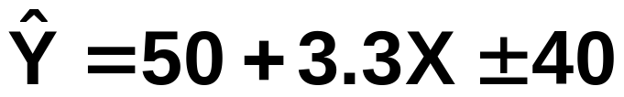
The estimated model:
Exercise
Use the prediction formula to estimate the loss incurred through equipment breakdown in Period 6, Fiscal 1962, when Y was 765 and X was 180.

Slide 53

Homework
Given the Volume figures for periods 1, 6 and 7 of Fiscal Year 1963, what predictions, including prediction errors, would you make for the Manhours requirement?
Recall:
How do these predictions relate to the actual manhours used?
Comment.

Slide 54
Case study:
Mail processing costs in a U.S. Post Office

Slide 55
Scatter plots of Manhours and Volume

Slide 56
Simple linear regression model with Normal model for chance variation
Y = α + βX + ε

Slide 57
Calculating the regression
by formula:
For these data,

Slide 58
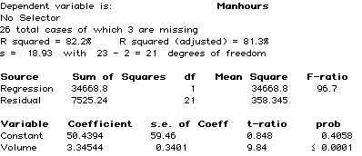
Calculating the regression
by computer

Slide 59
The "constant" variable?
Y = α + βX + ε
Y = α × 1 + β × X + ε

Slide 60
Calculating the prediction formula
Manhours = 50.4394 + 3.34544 × Volume
± 2 × 18.93

Slide 61
Standard errors of estimated regression coefficients
Regression coefficient estimate subject to chance variation
Normal model applies
Standard deviation of the Normal model is the standard error of the coefficient estimate

Slide 62



Application 1
Confidence interval for marginal change
Recall confidence interval for μ:
or
Confidence interval for β:

Slide 63
More results
Exercise: Calculate a 95% confidence interval for β.
Calculate a 95% CI for change in manhours corresponding to a 10m increase in pieces of mail handled.

Slide 64


Point Estimate
Standard Error
95% CI
3.34544
0.3401
3.34544 ± 2× 0.3401
3.34544 ± 0.6802
2.665 to 4.026

Slide 65

Point Estimate
Standard Error
95% CI
3.34544
0.3401
21 df
3.34544 ± 2.0796× 0.3401
3.34544 ± 0.7073
2.638 to 4.053
2.665 to 4.026 using betahat + 2 SE(betahat)

Slide 66
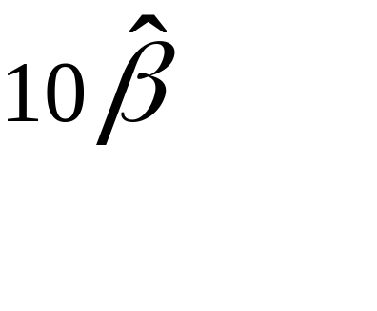
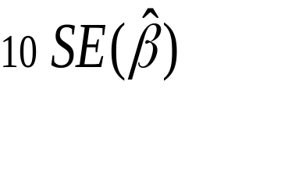
Point Estimate
Standard Error
95% CI
33.4544 ± 2× 3.401
33.4544 ± 6.802
26.65 to 40.26

Slide 67

Application 2
Testing the statistical significance of the slope
Formal test:
H₀: β = 0
Test statistic:
Calculated value: 9.84
Critical value: 2.0796 (t-dist, 21df) or 2 (approx)
Comparison: | 9.84 | > 2.0796 cutoff
Conclusion: REJECT H₀

